Slide 1
CP2404/CP5633 Database Modelling
Lecture 04

Slide 2
Lecture 4
Normalization
Reading: Coronel’s Chapter 6
Notes:
2

Slide 3
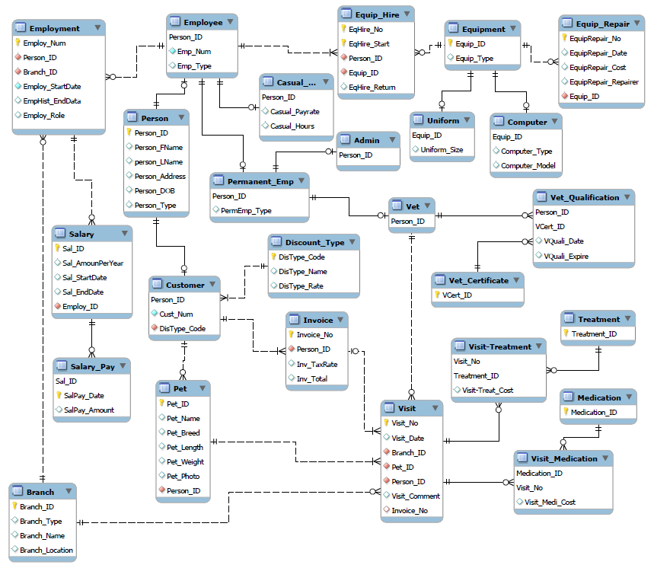
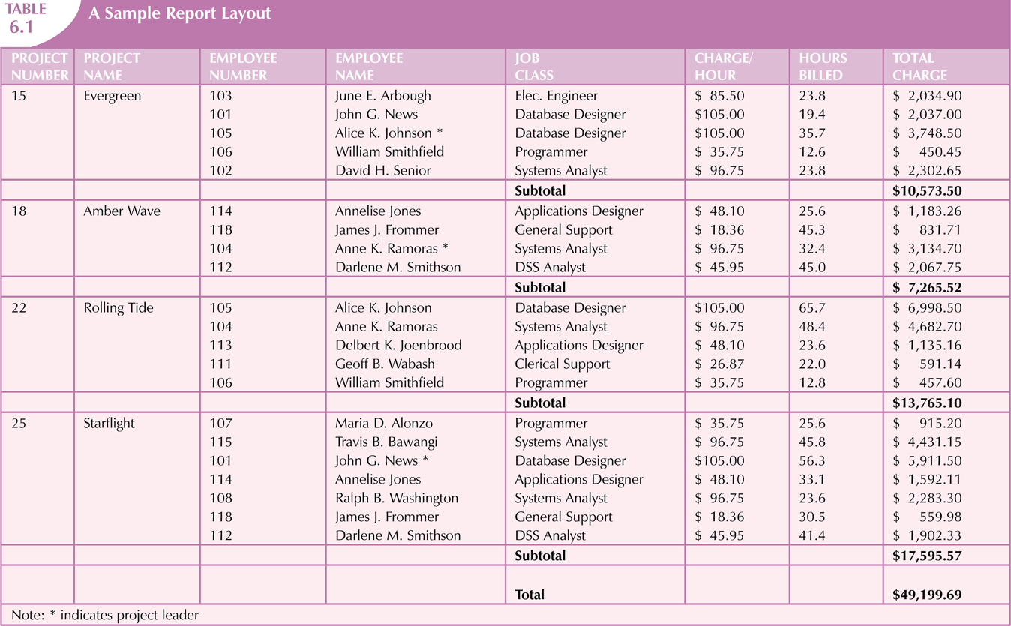
DB Modelling (ERD)
Business Rules
Database Model
…
FNQVC runs a head office in Cairns while the chain of vet clinics are located in multiple places including Cairns and other regional towns. The central database keeps information about branches, staff, equipment, customers and their pets, and visit information. Each branch has an ID number that uniquely identifies the branch and the authorized users of the database should be able to track the branch’s name, location, and details of employees (staff) who currently works for the specific branch.
…

Slide 4
Learning Objectives
In this lecture, you will learn:
What normalization is and what role it plays in the database design process
About the normal forms 1NF, 2NF, 3NF, and BCNF
How normal forms can be transformed from lower normal forms to higher normal forms
That normalization and ER modeling are used concurrently to produce a good database design
That some situations require denormalization to generate information efficiently
Notes:
4

Slide 5
raw data samples
5
Notes:
5
Example: Company that manages building projects
Charges its clients by billing hours spent on each contract
Hourly billing rate is dependent on employee’s position
Periodically, report is generated that contains information displayed in the table shown in next slide

Slide 6
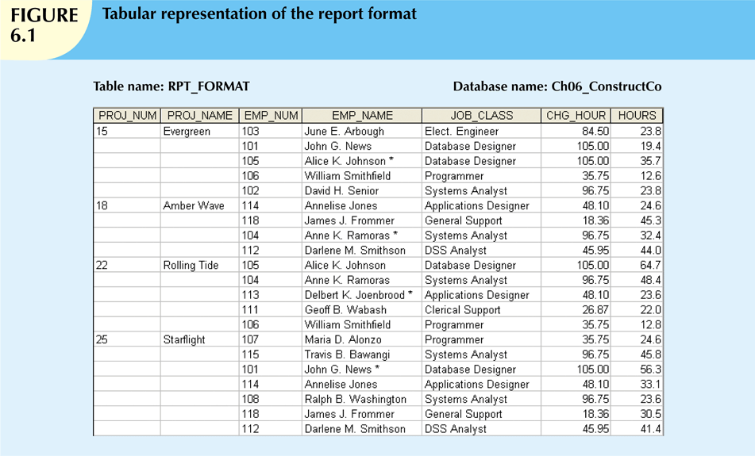
Better format but still not eligible for DB
6
Notes:
6
Structure of data set in Figure 5.1 does not handle data very well
The table structure appears to work; report generated with ease
Unfortunately, report may yield different results depending on what data anomaly has occurred

Slide 7
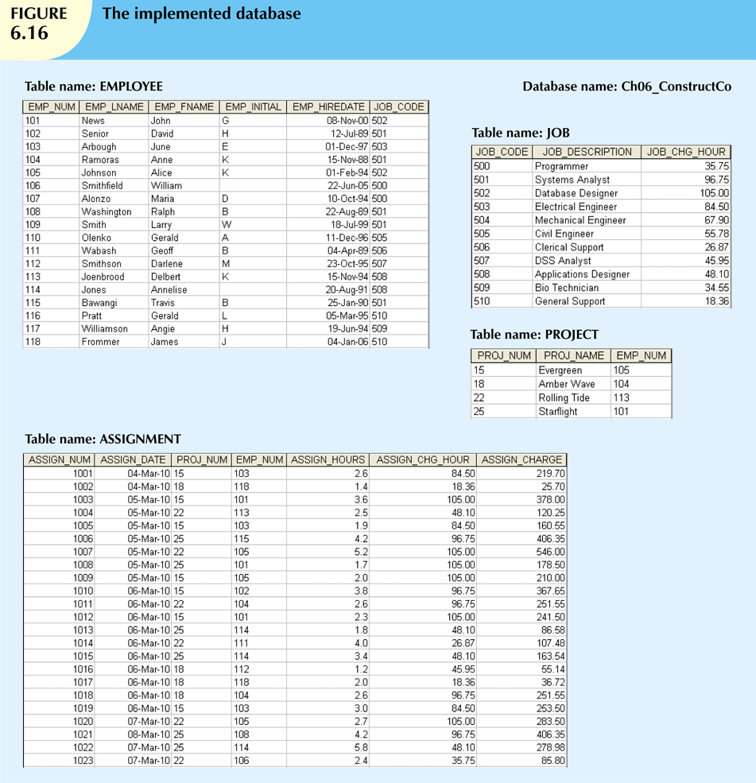
All are eligible for DB!

Slide 8
Normalization

Slide 9
What is Normalization?
Normalization
Process for evaluating and correcting table structures to minimize data redundancies
Reduces data anomalies
- Assigns attributes to tables based on determination
In a (well) normalized table structures:
Each table represents a single subject
No data item will be unnecessarily stored in more than one table
All attributes in a table are dependent on the primary key
9
Notes:
9

Slide 10
In a (well) normalized table structures:
Each table represents a single subject
No data item will be unnecessarily stored in more than one table
All attributes in a table are dependent on the primary key
10
Notes:
10

Slide 11
The Normalization Process
Works through a series of stages : normal forms
First normal form (1NF)‏
Second normal form (2NF)‏
Third normal form (3NF)‏
Higher normal forms are generally better than lower normal forms
11
Notes:
11

Slide 12
Need for Normalization
An important part of designing a new database structure
Analyses the relationship among the attributes within each entity
Determines if the structure can be improved
Improves the existing data structure and creates an appropriate database design
(Each table is free from anomalies of insertion, update, and deletion)
12
Notes:
12

Slide 13
Guide for General Normalization Process
Target to normalize all tables in at least 3NF
Higher forms (4NF or BCNF) are not necessary in most business environment
Work one table at a time
How?
Identify the dependencies of each table
Progressivly break the table into new set of tables
13
Notes:
13

Slide 14
Normalization Process – How?
For each table:
Identify the dependencies among attributes in the table
Progressivly break the table into new set of tables
14
Notes:
14

Slide 15
Functional Dependence Concepts
attribute A determines attribute B
B is functionally dependent on A
Each value of A determines one and only one value of B
For one A value, only one B value exists
A is a determinant attribute & B is a dependant attribute
A → B

Slide 16
Partial Dependency / Transitive Dependency
If (A+B)→(C,D,…) and (A+B) is the primary key
if B→C, this functional dependence (B→C) is a partial dependency
if C→D, this functional dependence (C→D) causes a transitive dependency

Slide 17
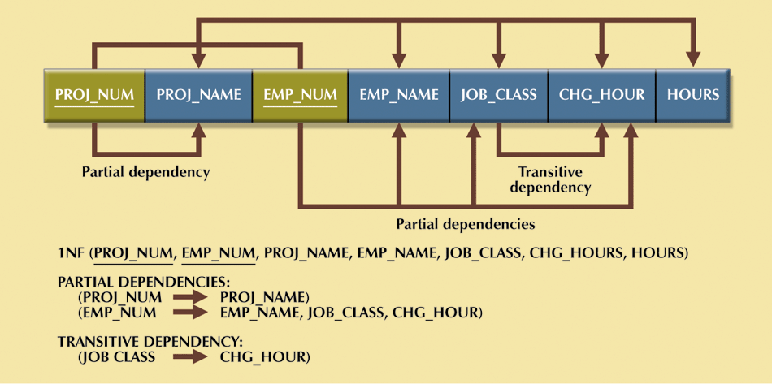
Dependency Diagram
REGULAR DEPENDENCY
(PROJ_NUM, EMP_NUM) → PROJ_NAME, EMP_NAME, JOB_CLASS, CHG_HOUR, HOURS
17
Notes:
17

Slide 18
Dependency Diagram
Desirable dependencies based on primary key (above the diagram)‏
Less desirable dependencies (below the diagram):
Partial dependencies (based on part of composite primary key)‏
Transitive dependencies (one nonprime attribute depends on another nonprime attribute)‏
18

Slide 20
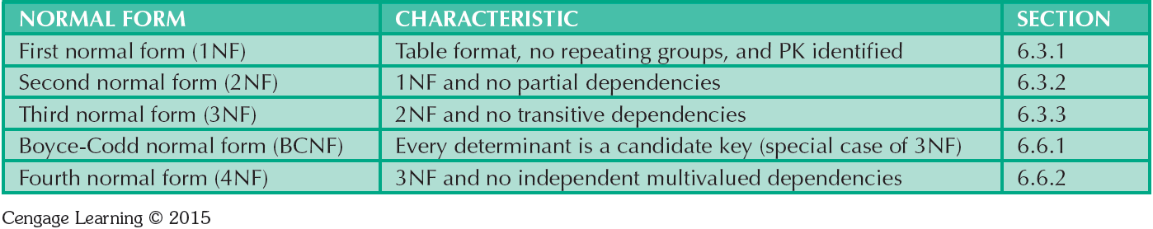
The Normalization Process
20
Notes:
20

Slide 21
First Normal Form (1NF)
There are no repeating groups in the table
All the key attributes are defined
All attributes are dependent on the primary key
All relational tables satisfy 1NF requirements
May contain other (partial or transitive) dependencies thus subject to data redundancies and various anomalies
21
Notes:
21

Slide 22
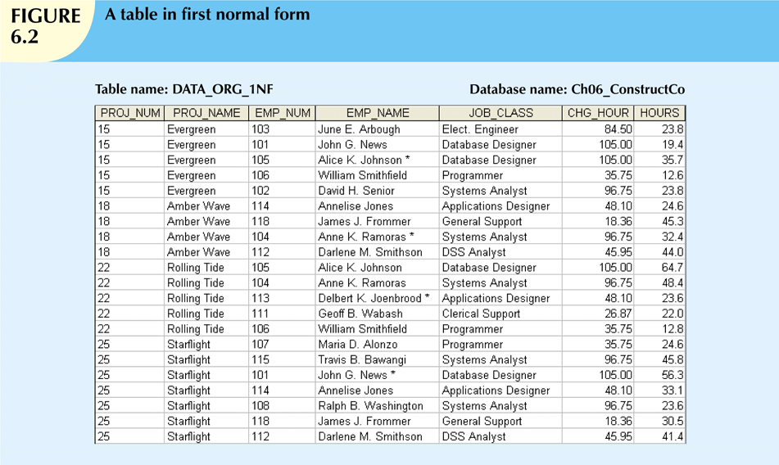
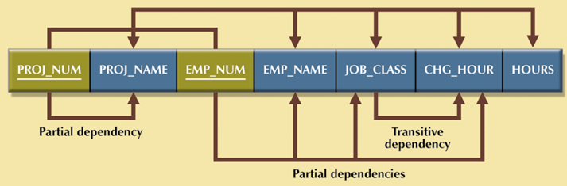
Conversion to First Normal Form (NNF → 1NF)
< Non-Normal Form >
Step 1: Eliminate the Repeating Groups
Fill the empty cells with appropriate values
Step 2: Identify the Primary Key
New key must be composed
Step 3: Identify All Dependencies
< 1st Normal Form >
22
22

Slide 23
Second Normal Form (2NF)
Table is in second normal form (2NF) when:
It is in 1NF and
It includes no partial dependencies:
No attribute is dependent on only portion of primary key
23

Slide 24
Conversion to Second Normal Form (1NF → 2NF)
Step 1: Identify Each New Determinant
Step 2: Identify the Dependent Attributes
Step 3: Remove the Dependent Attributes from Partial Dependencies by Creating a New Table
24

Slide 25
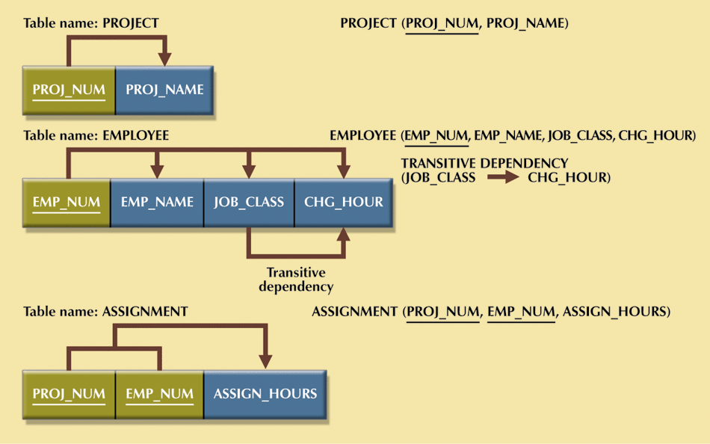
Conversion to Second Normal Form (1NF → 2NF)
< 1st Normal Form >
< 2nd Normal Form >
Step 1: Identify Each New Determinant
Step 2: Identify the Dependent Attributes
Step 3: Remove the Dependent Attributes from Partial Dependencies by Creating a New Table
FK
25

Slide 26
Third Normal Form (3NF)
A table is in third normal form (3NF) when both of the following are true:
It is in 2NF
It contains no transitive dependencies
26

Slide 27
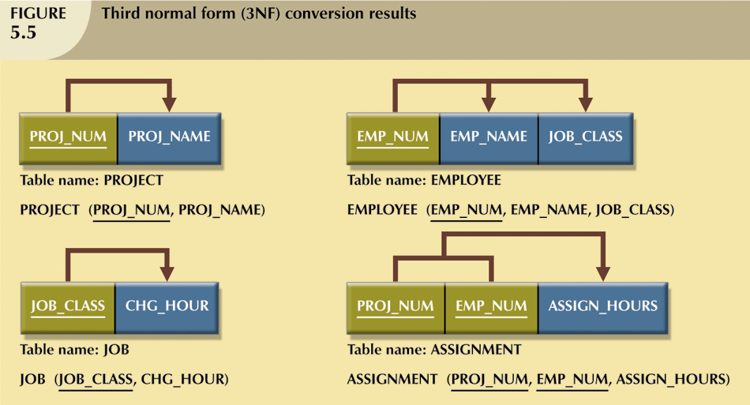
Conversion to Third Normal Form
<2NF>
< 3rd Normal Form>
Step 1: Identify Each New Determinant
Step 2: Identify the Dependent Attributes
Step 3: Remove the Dependent Attributes from Transitive Dependencies by Creating a New Table
FK
27
27

Slide 28

What normal forms?
stud-id, lecturer-name, grade
stud-id, subject-code, semester, stud-name, text-isbn, grade
bike-no, date-hire, date-return, cust-no, cust-name

Slide 30
Current - 3rd Normal Form
What’s next ?
Try to improve this current version

Slide 31
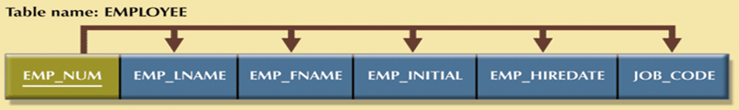


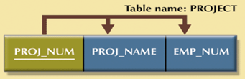
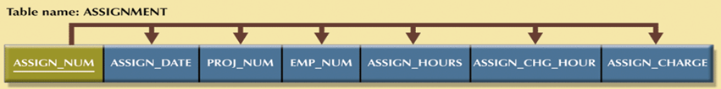
Improving the Design
31
Notes:
31
Add JOB_CODE as primary key for JOB:
JOB_CODE → JOB_CLASS, CHG_HOUR
Naming conventions:
CHG_HOUR → JOB_CHG_HOUR
JOB_CLASS → JOB_DESCRIPTION
HOURS → ASSIGN_HOURS
Add JOB_CHG_HOUR into the ASSIGN table for historical change of the job charges.
Add derived attribute ASSIGN_CHARGE into the ASSIGN table:
ASSIGN_CHARGE = ASSIGN_HOURS * ASSIGN_CHG_HOUR

Slide 32
Improving the Design
Issues to address in order to produce a good normalized set of tables:
Evaluate PK assignments
Evaluate naming conventions
Refine attribute atomicity (not further subdivided)
Identify new attributes
Identify new relationships
Refine PKs as required for data granularity
Maintain historical accuracy
Evaluate using derived attributes
32

Slide 33
Surrogate Key Considerations
When primary key is considered to be unsuitable, designers use surrogate keys
System-defined attribute
Created and managed via the DBMS
Have a numeric value which is automatically incremented for each new row
33

Slide 34
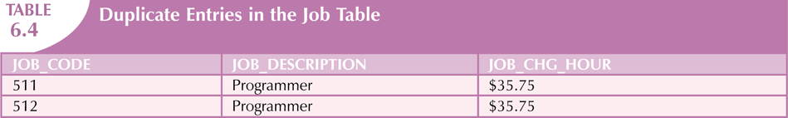
Surrogate Key Considerations
Data entries in the table below are inappropriate because they duplicate existing records
Yet there has been no violation of either entity integrity or referential integrity
Which PK is better?
34

Slide 35
The Boyce-Codd Normal Form (BCNF)‏
BCNF is a special case of 3NF.
A table is in Boyce-Codd normal form (BCNF) if every determinant in the table is a candidate key.
A determinant is any attribute whose value determines other values within a row.
If a table contains only one candidate key, the 3NF and the BCNF are equivalent.
35
Notes:
35
Table can be in 3NF and fails to meet BCNF
No partial dependencies, nor does it contain transitive dependencies
A nonkey attribute is the determinant of a key attribute

Slide 36
3NF and BCNF (equivalent)‏
All tables above contain only one candidate key

Slide 37
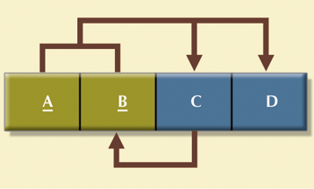
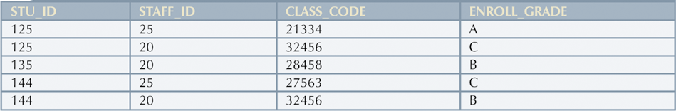
3NF But Not BCNF
A nonkey attribute is the determinant of a key attribute!
A + B -> C, D
C -> B (This dependency is NOT transitive!)‏
CLASS CODE is not a candidate key !!
37

Slide 38
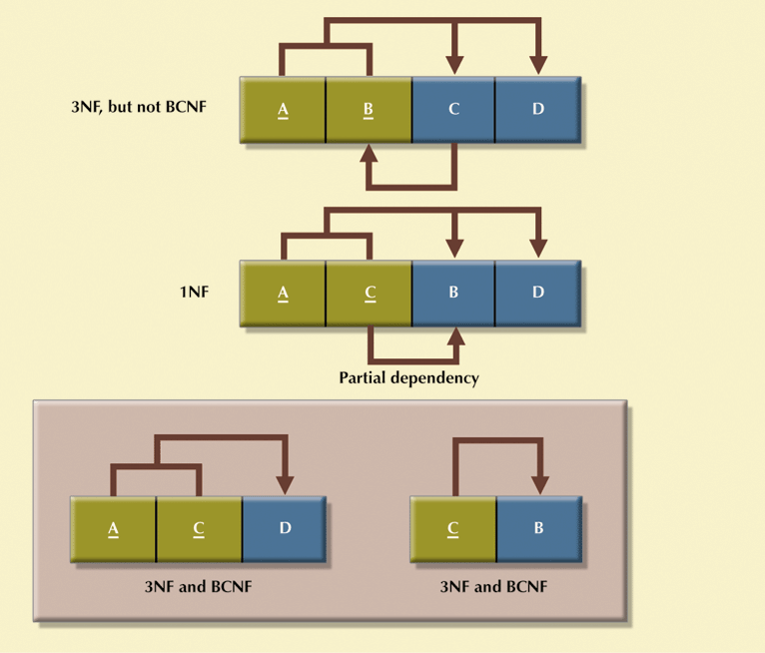
Decomposition to BCNF
38

Slide 40
Normalization and Database Design
Normalization should be part of the design process
E-R Diagram provides macro view
Normalization provides micro view of entities
Focuses on characteristics of specific entities
May yield additional entities
Difficult to separate normalization from E-R diagramming
Business rules must be determined
40

Slide 41

DB Modelling
…
FNQVC runs a head office in Cairns while the chain of vet clinics are located in multiple places including Cairns and other regional towns. The central database keeps information about branches, staff, equipment, customers and their pets, and visit information. Each branch has an ID number that uniquely identifies the branch and the authorized users of the database should be able to track the branch’s name, location, and details of employees (staff) who currently works for the specific branch.
…

Slide 42
VS.
42

Slide 43
Denormalization
Produces a lower normal form
Increases performance but increases data redundancy too
Why Denormalize?
Normalization is one of many database design goals
BUT,
Normalized table requirements
Additional processing
Loss of system speed
Normalization purity is difficult to sustain due to conflict in:
Design efficiency
Information requirements
Processing speed
Need Denormalization?
43

Slide 44
Denormalization (Example)‏
Processing
Speed
?
Data
Anomalies
Shall we produce a separate table: ZIP (ZIP_CODE, CITY), to remove the transitive dependency in a customer address table?
What if you are in the business of producing mailing lists?
44

Slide 45
Denormalization - Caution!
Unnormalized tables defects:
Data updates less efficient
Indexing more cumbersome
Use denormalization cautiously
45

Slide 46
Summary
Normalization is technique used to design tables in which data redundancies are minimized
First three normal forms (1NF, 2NF, and 3NF) are most commonly encountered
Normalization is important part—but only part—of design process
Tables are sometimes denormalized to yield less I/O which increases processing speed
46
Notes:
46

